Slide 1
Advanced Encryption Standards (AES)
AES is a symmetric-key block cipher.
Published by the National Institute of Standards and Technology (NIST) in December 2001.
.

Slide 2
History
In 1997, NIST started looking for a replacement for DES.
The NIST specifications required a block size of 128 bits and 3 different key sizes of 128, 192, and 256 bits.
The specifications also required that AES be an open algorithm, available to the public worldwide.
The announcement was made internationally to solicit responses from all over the world.
.

Slide 3
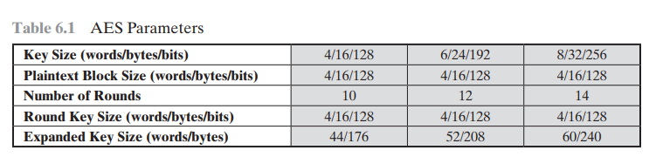
Rounds
AES is a non-Feistel cipher.
Encrypts and decrypts a data block of 128 bits.
It uses 10, 12, or 14 rounds.
The key size, which can be 128, 192, or 256 bits, depends on the number of rounds.
.

Slide 4
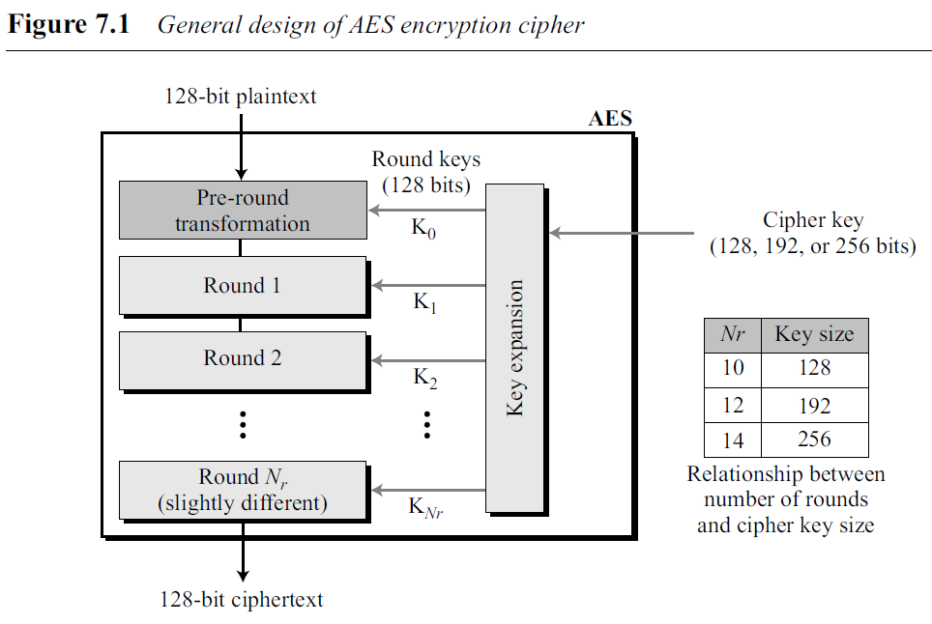
Rounds
Nr defines the number of rounds.
3 different AES versions: AES-128, AES-192, and AES-256.
Round keys created by the key-expansion algorithm are always 128 bits
.

Slide 5
AES has defined three versions, with 10, 12, and 14 rounds.
Each version uses a different cipher key size (128, 192, or 256), but the round keys are always 128 bits.
The number of round keys generated by the key-expansion algorithm is always one more than the number of rounds.
In other words, we have Number of round keys = Nr + 1
We refer to the round keys as K₀, K₁, K₂, …, K_{Nr}
.

Slide 6
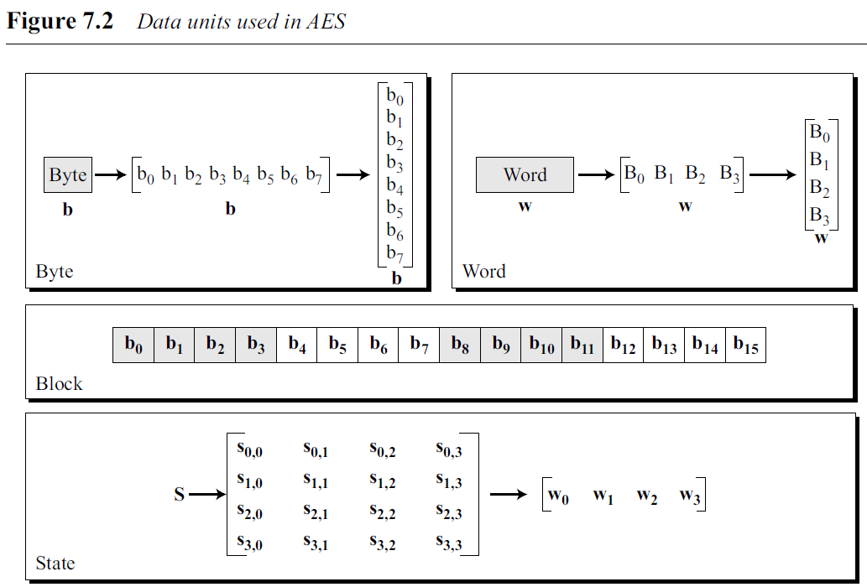
Data Units
AES uses 5 units of measurement to refer to data: bits, bytes, words, blocks, and state.
Bit is the smallest unit; other units can be expressed in terms of smaller ones.
.

Slide 7
Data Units
Bit
bit is a binary digit with a value of 0 or 1. lowercase letter to refer to a bit.
Byte
group of eight bits that can be treated as a single entity, a row matrix (1 × 8) of eight bits, or a column matrix (8 × 1) of eight bits.
When treated as a row matrix, the bits are inserted to the matrix from left to right; when treated as a column matrix, the bits are inserted into the matrix from top to bottom.
lowercase bold letter to refer to a byte.
Word
A word is a group of 32 bits that can be treated as a single entity, a row matrix of four bytes, or a column matrix of four bytes.
When it is treated as a row matrix, the bytes are inserted into the matrix from left to right; when it is considered as a column matrix, the bytes are inserted into the matrix from top to bottom.
We use the lowercase bold letter to show a word.
Block
AES encrypts and decrypts data blocks.
A block in AES is a group of 128 bits.
.

Slide 8
State
AES uses several rounds in which each round is made of several stages.
Data block is transformed from one stage to another.
At the beginning and end of the cipher, AES uses the term data block; before and after each stage, the data block is referred to as a state.
We use an uppercase bold letter to refer to a state.
Although the states in different stages are normally called S, letter T to refer to a temporary state.
.

Slide 9
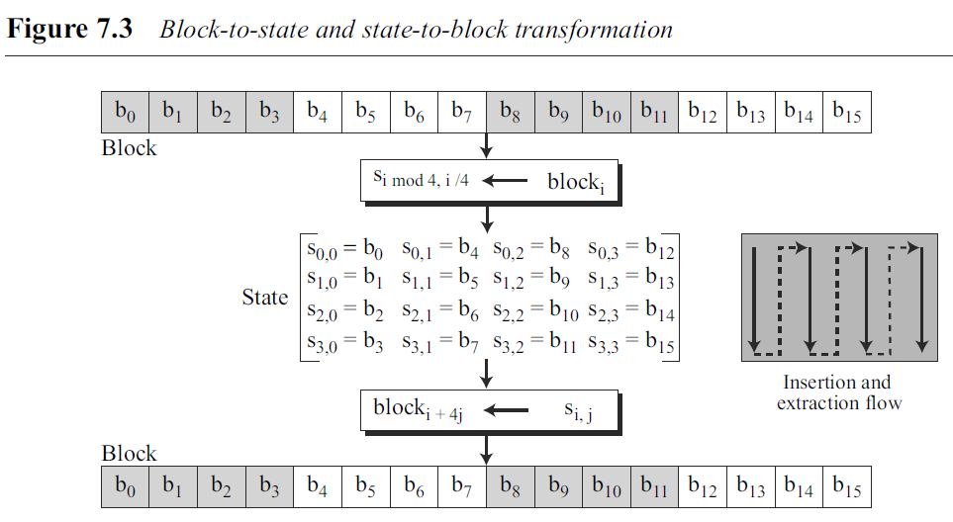
States, like blocks, are made of 16 bytes, but normally are treated as matrices of 4 × 4 bytes.
In this case, each element of a state is referred to as s_{r,c}, where r (0 to 3) defines the row and the c (0 to 3) defines the column.
.

Slide 10
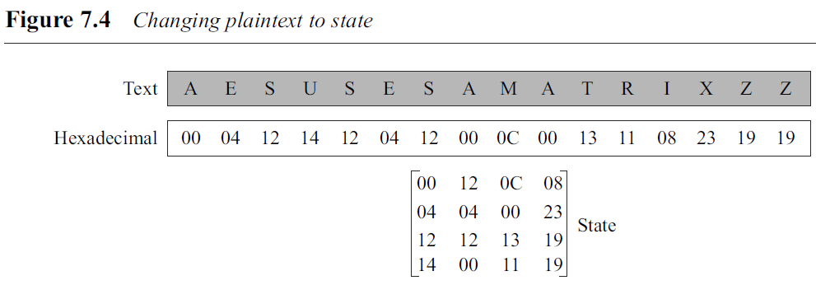
Example 7.1
Example: The text block is “AES uses a matrix”. We add two bogus characters at the end to get “AESUSESAMATRIXZZ”.
Replace each character with an integer between 00 and 25. Then show each byte as an integer with two hexadecimal digits.
.

Slide 11
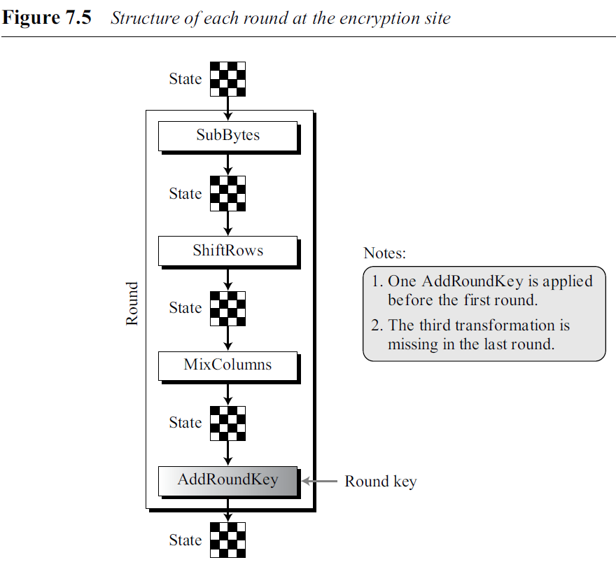
Structure of Each Round
Figure: structure of each round at the encryption side.
Each round, except the last, uses four transformations that are invertible. The last round has only 3 transformations.
Each transformation takes a state and creates another state to be used for the next transformation or the next round.
Pre-round section uses only one transformation (AddRoundKey); last round uses only three transformations (MixColumns is missing).
At the decryption site, the inverse transformations are used: InvSubByte, InvShiftRows, InvMixColumns, and AddRoundKey (this one is self-invertible).
.

Slide 12
7.2 TRANSFORMATIONS
To provide security, AES uses four types of transformations: substitution, permutation, mixing, and key-adding.
Substitution
The substitution is done for each byte.
Only one table is used for transformation of every byte.
Transformation is defined by either a table lookup process or mathematical calculation in the GF(2⁸) field.
AES uses two invertible transformations.
.

Slide 13
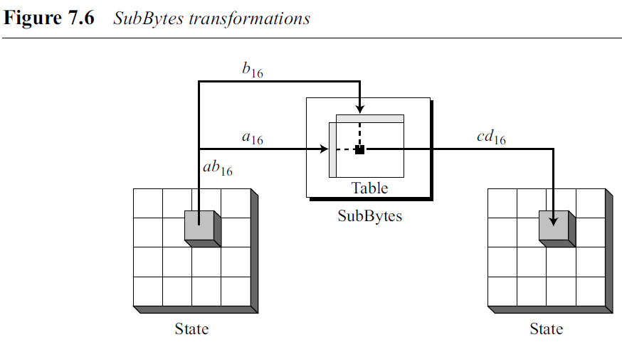
SubBytes
The first transformation is SubBytes.
Here interpret the byte as two hexadecimal digits.
Left digit defines the row and right digit defines the column of substitution table.
Two hexadecimal digits at the junction of the row and the column are the new byte.
.

Slide 14
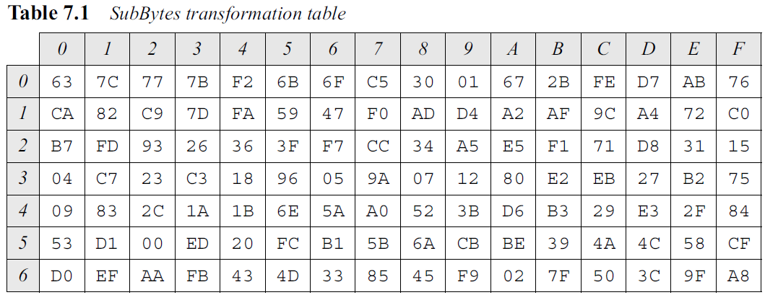
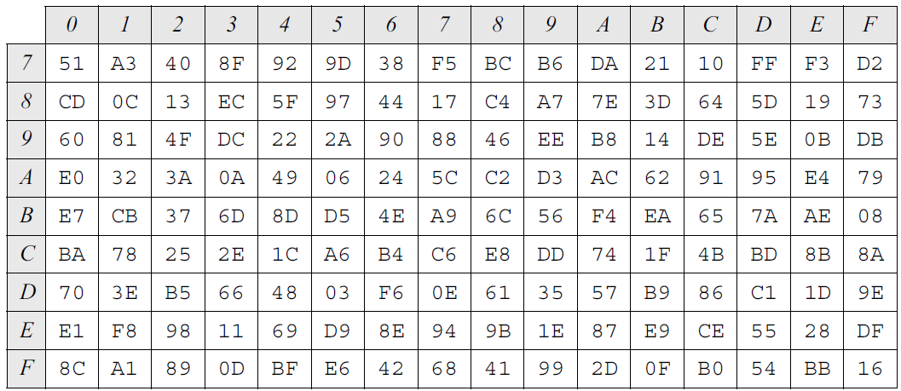
Table shows the substitution table (S-box) for SubBytes transformation. The transformation definitely provides confusion effect.
For example, two bytes, 5A₁₆ and 5B₁₆, which differ only in one bit (the rightmost bit) are transformed to BE₁₆ and 39₁₆, which differ in four bits.
.

Slide 15
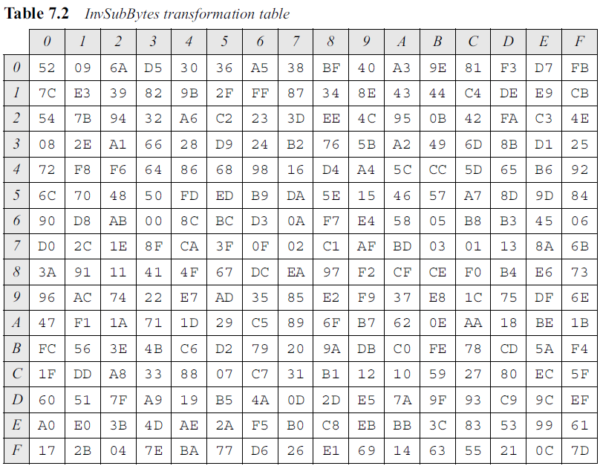
InvSubBytes
InvSubBytes is the inverse of SubBytes.
The transformation is done using Table 7.2.
.

Slide 16
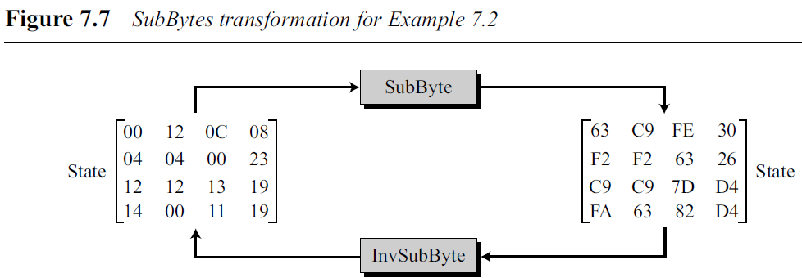
.

Slide 17
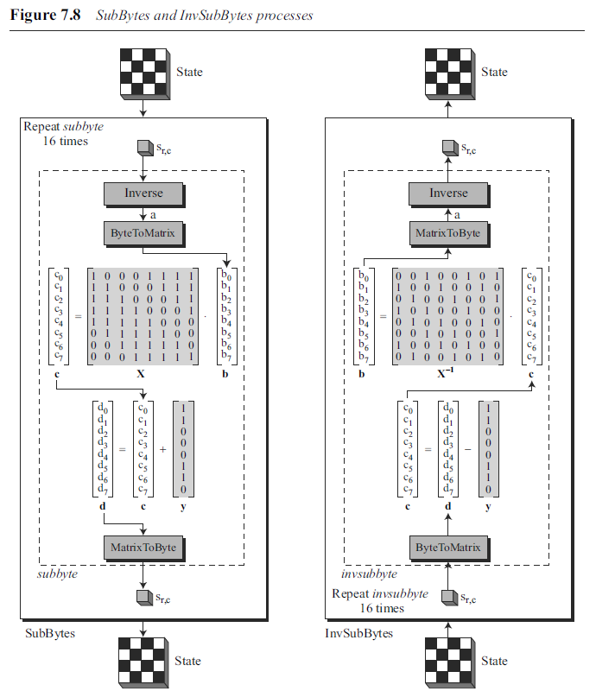
Transformation Using the GF(2⁸) Field
Although we can use Table 7.1 or Table 7.2 to find the substitution for each byte,
AES also defines the transformation algebraically using the GF(2⁸) field with the irreducible polynomials (x⁸ + x⁴ + x³+ x + 1), as shown in Figure 7.8.
SubBytes transformation repeats a routine, called subbyte, 16 times.
The InvSubBytes repeats a routine called invsubbyte.
Each iteration transforms one byte.
* GF is the initialism of Galois Field, another name for finite fields.
.

Slide 18
In the subbyte routine, the multiplicative inverse of the byte is found in GF(2⁸) with the irreducible polynomial (x⁸ + x⁴ + x³+ x + 1) as the modulus.
if the byte is 00₁₆, its inverse is itself.
The inverted byte is then interpreted as a column matrix.
This column matrix is multiplied by a constant square matrix, X, and the result is added with a constant column matrix, y, to give the new byte.
multiplication and addition of bits are done in GF(2).
.

Slide 19
The invsubbyte is doing the same thing in reverse order.
In the encryption, multiplication is first and addition is second; in the decryption, subtraction is first and division is second.
Two transformations are inverses of each other because addition or subtraction in GF(2) is actually the XOR operation.
.

Slide 20
Example 7.3 : How the byte 0C is transformed to FE by subbyte routine and transformed back to 0C by the invsubbyte routine.
1. subbyte:
a. Multiplicative inverse of 0C in GF(2⁸) field is B0, which means b is (10110000).
b. Multiplying matrix X by this matrix results in c = (10011101)
c. The result of XOR operation is d = (11111110), which is FE in hexadecimal.
2. invsubbyte:
a. The result of XOR operation is c = (10011101)
b. The result of multiplying by matrix X⁻¹ is (11010000) or B0
c. The multiplicative inverse of B0 is 0C.
.

Slide 21
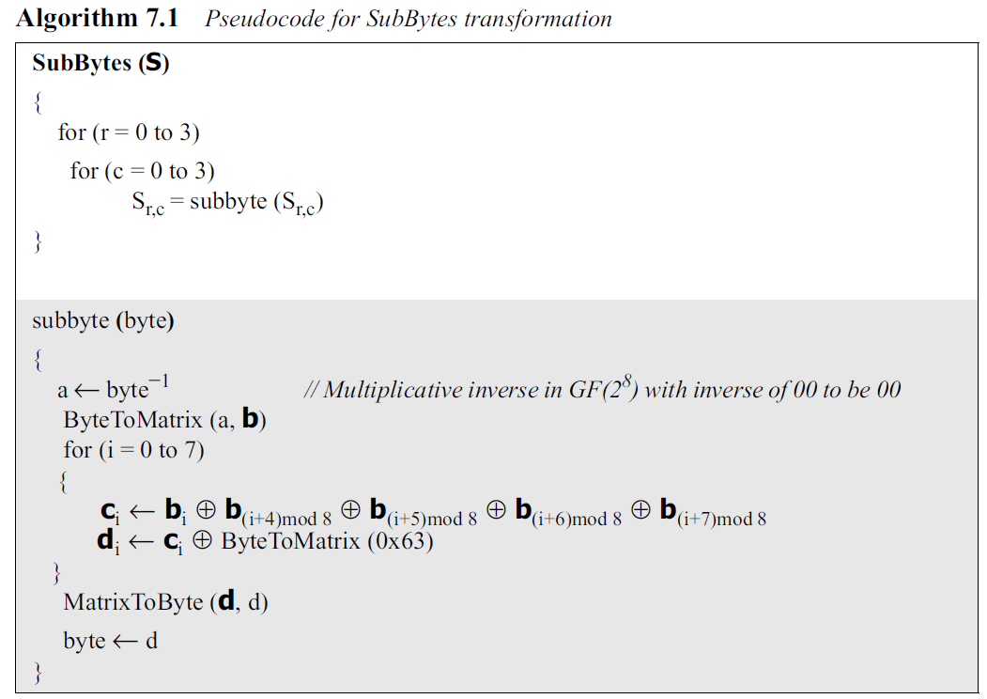
Algorithm
The algorithm does not necessarily use multiplication and addition of matrices because most of the elements in the constant square matrix are only 0 or 1.
The value of the constant column matrix is 0x63.
Algorithm 7.1 calls the subbyte routine 16 time, one for each byte in the state.
The ByteToMatrix routine transforms a byte to an 8 × 1 column matrix. The MatrixToByte routine transforms an 8 × 1 column matrix to a byte. The expansion of these routines and the algorithm for InvSubBytes are left as exercises.
.

Slide 22
Permutation
Another transformation found in a round is shifting, which permutes the bytes.
Shifting transformation in AES is done at the byte level.
ShiftRows
In the encryption, the transformation is called ShiftRows and the shifting is to the left.
The number of shifts depends on the row number (0, 1, 2, or 3) of the state matrix.
.

Slide 23
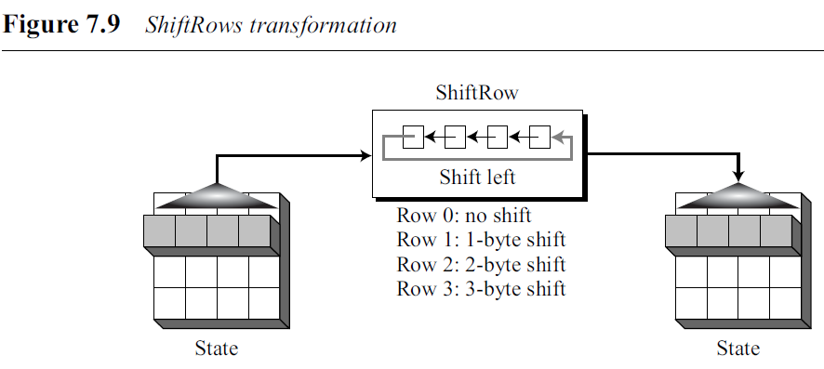
ShiftRows
In the encryption, the transformation is called ShiftRows and the shifting is to the left.
The number of shifts depends on the row number (0, 1, 2, or 3) of the state matrix.
This means the row 0 is not shifted at all and the last row is shifted three bytes.
The ShiftRows transformation operates one row at a time.
.

Slide 24
InvShiftRows
In the decryption, the transformation is called InvShiftRows and the shifting is to the right.
The number of shifts is the same as the row number (0, 1, 2, and 3) of the state matrix.
The ShiftRows and InvShiftRows transformations are inverses of each other
.

Slide 25
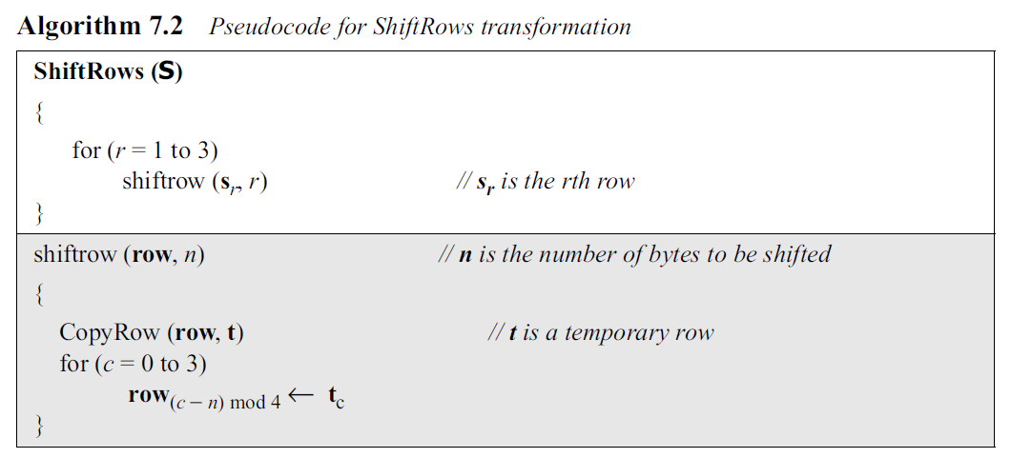
Algorithm
Transformation is one row at a time, routine called shiftrow that shifts the byte in a single row. Call this routine three times.
The shiftrow routine first copies the row into a temporary row matrix, t. It then shifts the row.
.

Slide 26
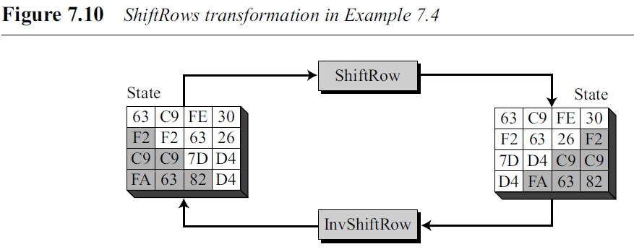
.

Slide 27
Mixing
SubBytes is an intrabyte transformation.
ShiftRows is a byte-exchange transformation.
Need an interbyte transformation that changes the bits inside a byte, based on the bits inside the neighboring bytes.
Need to mix bytes to provide diffusion at the bit level.
.

Slide 28
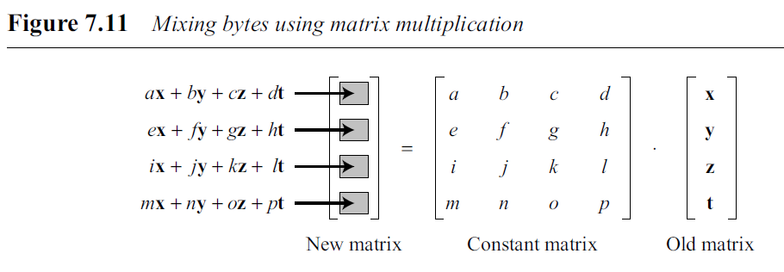
Mixing
Mixing transformation changes the contents of each byte by taking four bytes at a time and combining them to recreate four new bytes.
To guarantee that each new byte is different (even if all four bytes are the same), the combination process first multiplies each byte with a different constant and then mixes them.
.

Slide 29
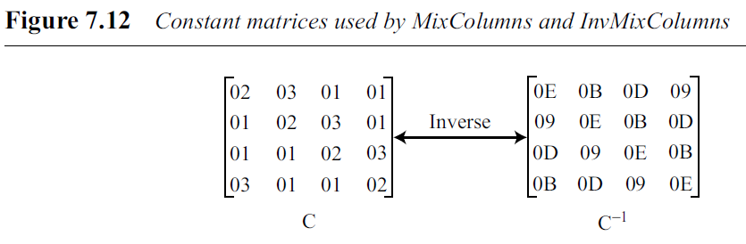
AES defines a transformation, called MixColumns, to achieve this goal.
There is also an inverse transformation, called InvMixColumns.
Figure shows the constant matrices used for these transformations.
These two matrices are inverses of each other when the elements are interpreted as 8-bit words (or polynomials) with coefficients in GF(2⁸).
.

Slide 30
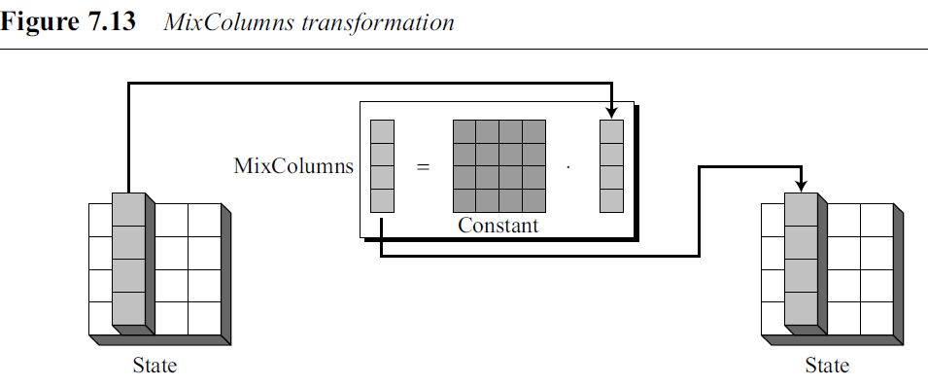
MixColumns
Transformation is actually the matrix multiplication of a state column by a constant square matrix.
The bytes in the state column and constants matrix are interpreted as 8-bit words (or polynomials) with coefficients in GF(2).
Multiplication of bytes is done in GF(2 ⁸) with modulus (10001101) or (x⁸ + x⁴ + x³ + x + 1).
Addition is the same as XORing of 8-bit words.
.

Slide 31
InvMixColumns
The InvMixColumns transformation is basically the same as the MixColumns transformation.
If the two constant matrices are inverses of each other, it is easy to prove that the two transformations are inverses of each other.
The MixColumns and InvMixColumns transformations are inverses of each other.
.

Slide 32
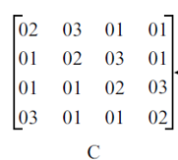
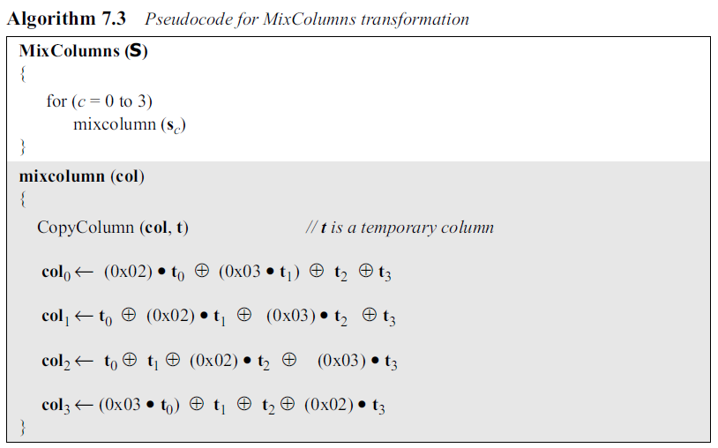
Algorithm 7.3 shows the code for MixColumns transformation
Algorithms for MixColumns and InvMixColumns involve multiplication and addition in the GF(2⁸) field.
The routine mixcolumn simply multiplies the rows of the constant matrix by a column in the state.
The operator (•) used in the mixcolumn routine is multiplication in the GF(2⁸) field.
It can be replaced with a simple routine as discussed in Chapter 4.
.

Slide 33
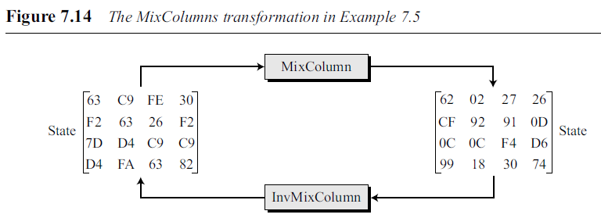
Example 7.5
Figure 7.14 shows how a state is transformed using the MixColumns transformation. The figure
also shows that the InvMixColumns transformation creates the original one.
Note that equal bytes in the old state are not equal any more in the new state. For example, the two bytes F2 in the second row are changed to CF and 0D.
.

Slide 34
Key Adding
Most important transformation is the one that includes the cipher key.
If the cipher key is not added to the state at each round, it is very easy for the adversary to find the plaintext, given the ciphertext.
Each round key is 128 bits long. It is treated as four 32-bit words.
Each word is considered as a column matrix.
.

Slide 35
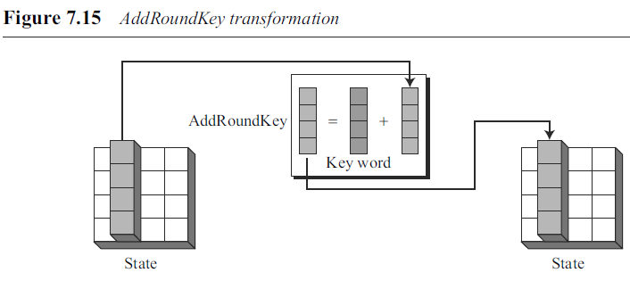
AddRoundKey
AddRoundKey adds a round key word with each state column matrix.
The operation in AddRoundKey is matrix addition.
Since addition and subtraction in this field are the same, the AddRoundKey transformation
is the inverse of itself.
The AddRoundKey transformation is the inverse of itself.
.

Slide 36
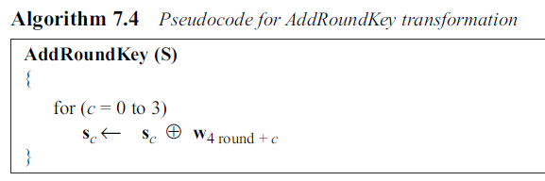
Algorithm
The AddRoundKey transformation can be thought as XORing of each column of the
state, with the corresponding key word.
Note that sc and w_{round+4c} are 4 × 1 column matrices.
The ⊕ operator here means XORing two column matrices, each of 4 bytes.
.

Slide 37
7.3 KEY EXPANSION
Key-expansion process to create round key for each round,
If the number of rounds is Nr, key-expansion routine creates Nr+1 128-bit round keys.
First round key is used for pre-round transformation (AddRoundKey);
Remaining round keys are used for the last transformation (AddRoundKey) at the end of each round.
.

Slide 38

7.3 KEY EXPANSION
key-expansion routine creates round keys word by word, where a word is an array of 4 bytes.
The routine creates 4 × (Nr +1) words.
In AES-128 version (10 rounds), there are 44 words;
In AES- 192 version (12 rounds), there are 52 words;
In AES-256 version (with 14 rounds), there are 60 words.
Each round key is made of four words.
.

Slide 39
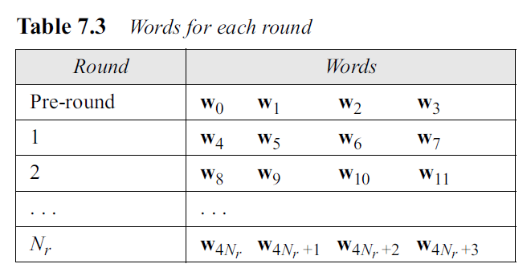
7.3 KEY EXPANSION
Relationship between rounds and words.
.

Slide 40
Key Expansion in AES-128
Creation of words for the AES-128 version;
Processes for the other two versions are the same with some slight changes.
Figure shows how 44 words are made from the original key.
.

Slide 41

The process is as follows:
1. The first four words (w₀, w₁, w₂, w₃) are made from the cipher key. The cipher key is thought of as an array of 16 bytes (k₀ to k₁₅).
2. The rest of the words (wi for i = 4 to 43) are made as follows:
If (i mod 4) ≠ 0, wi = w_{i−1} ⊕ w_{i−4}. This means each word is made from the one at the left and the one at the top.
b. If (i mod 4) = 0, wi = t ⊕ w_{i−4}.
Here t, a temporary word, is the result of applying two routines, SubWord and RotWord, on w_{i−1} and XORing the result with a round constants, RCon. In other words, we have,
.

Slide 42
RotWord
The routine takes a word as an array of four bytes and shifts each byte to the left with wrapping.
Ex: input word [b₀,b₁,b₂,b₃] is transformed into [b₁, b₂,b₃,b₀]
SubWord
The SubWord (substitute word) routine is similar to the SubBytes transformation, but it is applied only to four bytes.
The routine takes each byte in the word and substitutes another byte for it.
Round Constants
Each round constant, RCon, is a 4-byte value in which the rightmost 3 bytes are always zero.
Table 7.4 shows the values for AES-128 version (with 10 rounds).
.

Slide 43
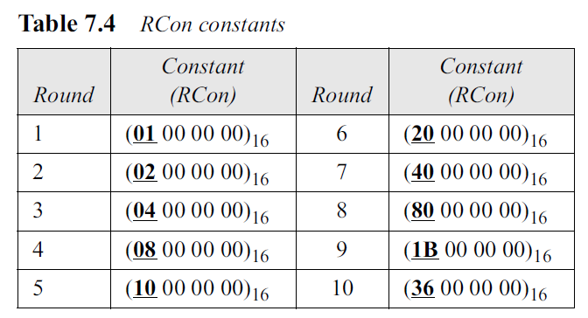
Round Constants
Each round constant, RCon, is a 4-byte value in which the rightmost three bytes are always zero.
Table 7.4 shows the values for AES-128 version (with 10 rounds).
.

Slide 44
Key expansion in AES-192 and AES 256
In AES-192 words are generated in groups of 6 instead of 4 (w_{o} to w₅)
In AES-256 words are generated in groups of 8 instead of 4 (w_{o} to w₇)
.

Slide 45
8.1 USE OF MODERN BLOCK CIPHERS
The two modern block ciphers namely DES and AES, are designed to encipher and decipher a block of text of fixed size.
DES encrypts and decrypts a block of 64 bits; AES encrypts and decrypts a block of 128 bits.
In reallife applications, the text to be enciphered is of variable size and normally much larger than 64 or 128 bits.
.

Slide 46
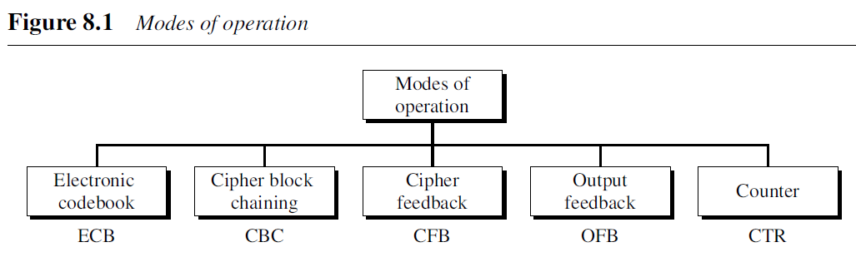
Modes of operation have been devised to encipher text of any size employing either DES or AES.
Figure shows the 5 modes of operation
.

Slide 47
Electronic Codebook (ECB) Mode
The simplest mode of operation.
The plaintext is divided into N blocks. The block size is n bits.
If the plaintext size is not a multiple of the block size, the text is padded to make the last block the same size as the other blocks.
The same key is used to encrypt and decrypt each block.
.

Slide 48
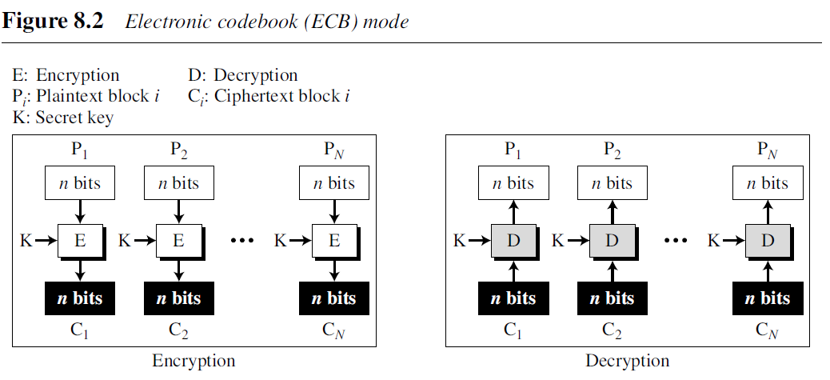
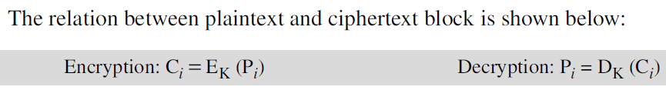
Electronic Codebook (ECB) Mode
.

Slide 49
Cipher Block Chaining (CBC) Mode
In CBC mode, each plaintext block is exclusive-ored with the previous ciphertext block before being encrypted.
When a block is enciphered, the block is sent, but a copy of it is kept in memory to be used in the encryption of the next block.
The reader may wonder about the initial block. There is no ciphertext block before the first block.
In this case, a phony block called the initialization vector (IV) is used.
The sender and receiver agree upon a specific predetermined IV.
.

Slide 50
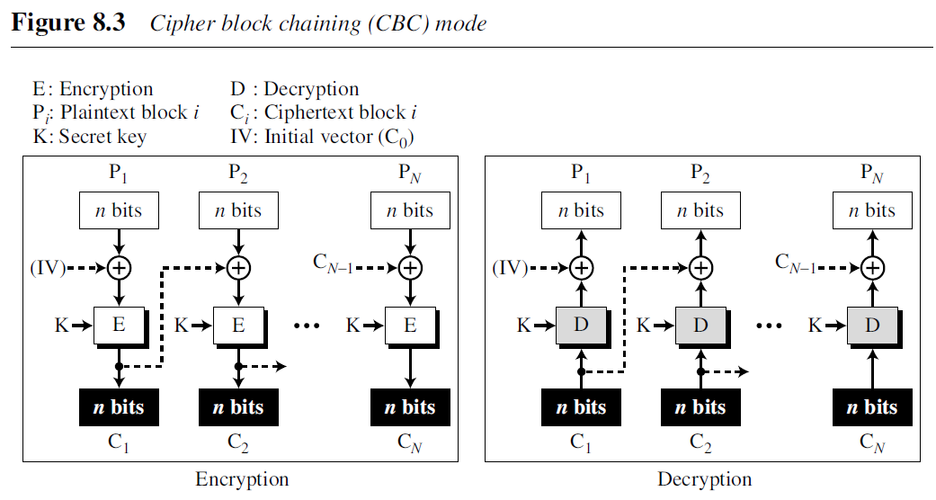
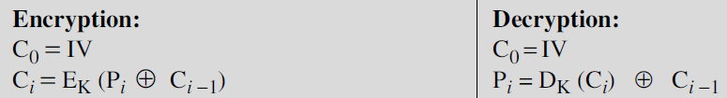
Cipher Block Chaining (CBC) Mode
Figure 8.3 shows CBC mode. At the sender side, exclusive-oring is done before encryption; at the receiver site, decryption is done before exclusive-oring.
The relation between plaintext and ciphertext blocks is shown below:
.

Slide 51
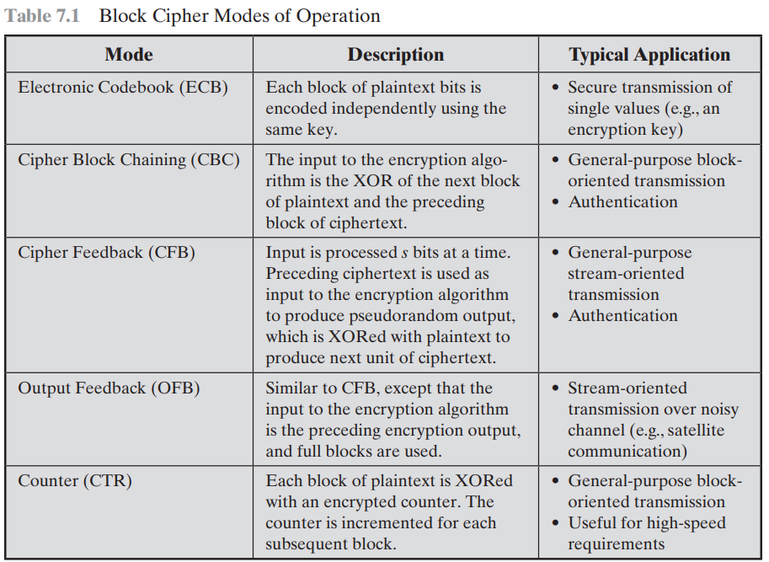
Modes of operations
.

Slide 52
Cipher Feedback (CFB) Mode
In some situations, we need to use DES or AES as secure ciphers, but the plaintext or ciphertext block sizes are to be smaller.
For example, to encrypt and decrypt ASCII 8-bit characters, you would not want to use one of the traditional ciphers because they are insecure.
The solution is to use DES or AES in cipher feedback (CFB) mode.
In this mode the size of the block used in DES or AES is n, but the size of the plaintext or ciphertext block is r, where r <=n
.

Slide 53
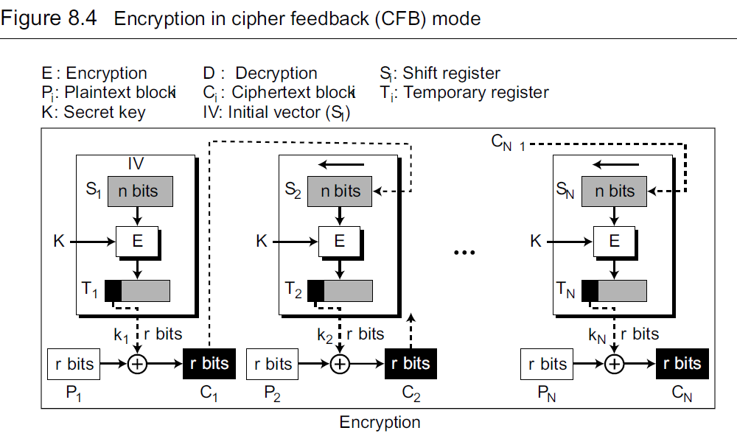
Cipher Feedback (CFB) Mode
.

Slide 54
Cipher Feedback (CFB) Mode
In CFB mode, encipherment and decipherment use the encryption function of the underlying block cipher.
The relation between plaintext and ciphertext blocks is shown below:
.

Slide 55
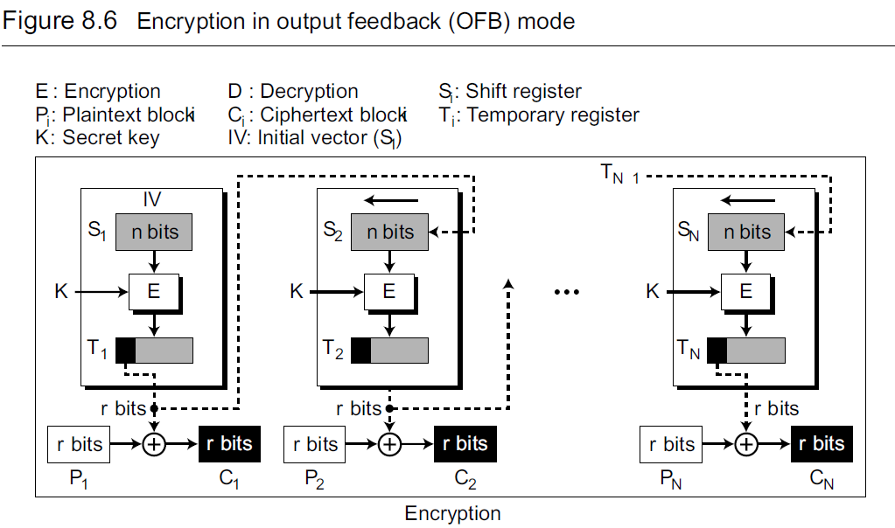
Output Feedback (OFB) Mode
.

Slide 56
Counter (CTR) Mode
In the counter (CTR) mode, there is no feedback.
An n-bit counter is initialized to a pre-determined value (IV) and incremented based on a predefined rule.
To provide a better randomness, the increment value can depend on the block number to be incremented.
.

Slide 57
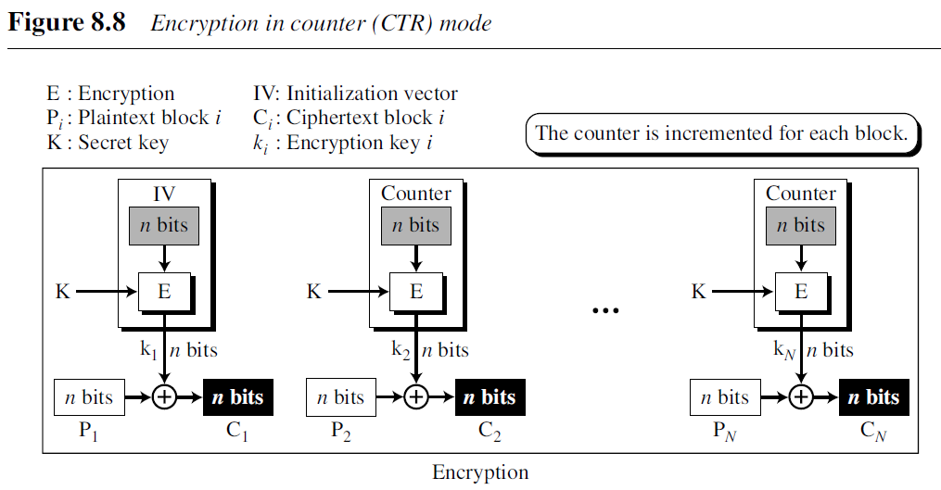
Counter (CTR) Mode
The relation between plaintext and ciphertext blocks is shown below.
.

Slide 58
END
.

